Slide 1


Green Pace
Security Policy Presentation
Developer: Dan Stull

Slide 2

OVERVIEW: DEFENSE IN DEPTH

Slide 3
THREATS MATRIX
Risk Assessment:
Of the ten standards
2 x High
3 x Medium
5 x Low
The matrix shows the priority level, severity, likelihood, and remediation costs.
Likely Attacks most likely to occur | Priority High priorities tend to have higher severity level
Low priority Expensive to repair but low exploitable. | Unlikely Attacks least likely to occur

Slide 4
10 PRINCIPLES
Validate Input Data
Heed Compiler Warnings
Architect and Design for Security Policies
Keep it Simple
Default Deny
Adhere to the Principle of Least Privilege
Sanitize Data Sent to Other Systems
Practice Defense in Depth
Use Effective Quality Assurance Techniques
Adopt a Secure Coding Standard

Slide 5
CODING STANDARDS
Implement Abstract Data Types Using Opaque Types
Do Not Use Floating-point Variables in Loop Counters
Do Not Attempt To Modify String Literals
Prevent SQL Injection
Free Dynamically Allocated Memory When No Longer Needed
Use A Static Assertion To Test the Value of a Constant Expression
Honor Exception Specifications
Value-returning Function Must Return a Value From All Exit Paths
Allocate Sufficient Memory for an Object
Clear Sensitive Information Stored in Reusable Resources

Slide 6
ENCRYPTION POLICIES
Encryption in Rest: Data is encrypted when being stored; data is still accessible as a readable type but can only be accessed with the proper key.
Encryption at Flight: Data is encrypted while transmitted. Data is not encrypted while being stored or while being read, only while on the move. Works well for team members transferring files back and forth.
Encryption in Use: Data is encrypted while in use/being read. This gives certain users privilege depending on security access level. Prevents new/lower lever employees from accessing the data or the system.

Slide 7
TRIPLE-A POLICIES
Authentication: Uses passwords/codes, secure networks, usernames/logins, sometimes facial and fingerprint recognition, as well as two-feature identification depending on the user and security level.
Authorization: Leverages features of authentication to identify correct levels of access.
Accounting: Leverages features from both authentication and authorization to account for—or audit—the traffic on the system.

Slide 8
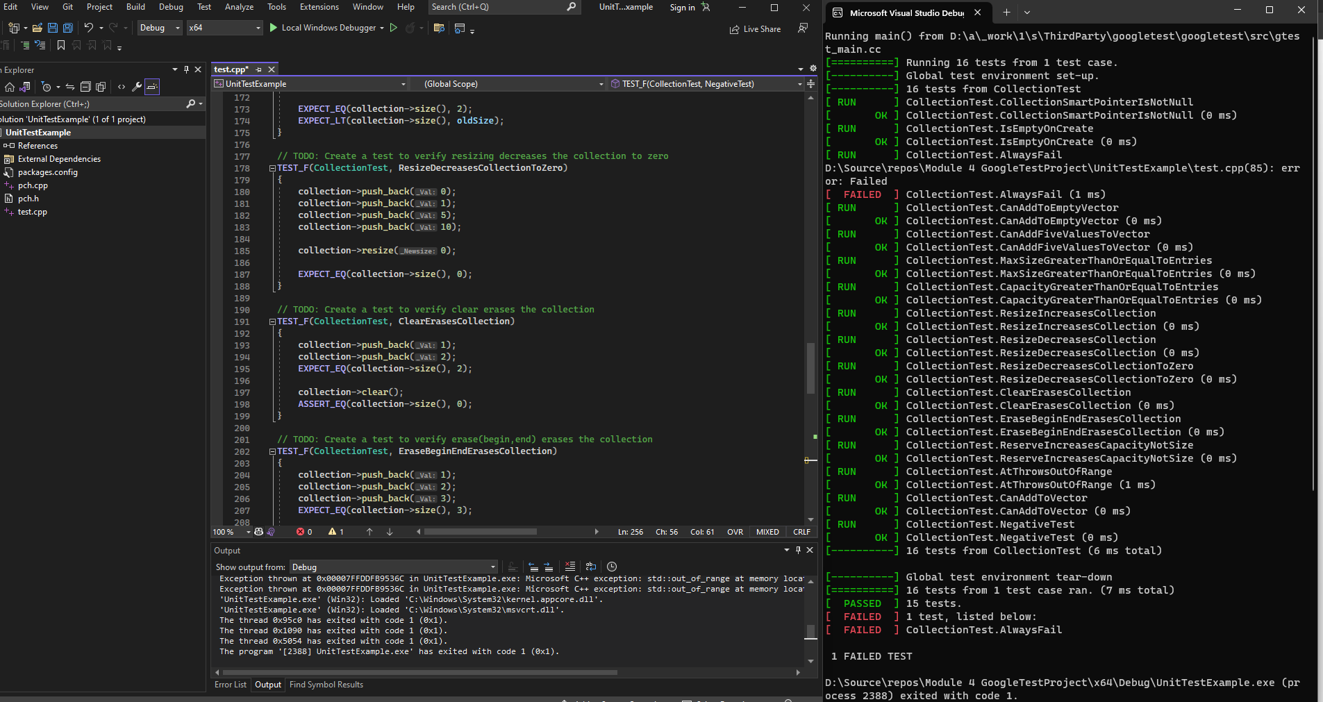
Unit Testing
Google Unit Testing:
Unit Testing can catch many vulnerabilities within a system. With this case here, a unit catch is the data is not resized, deleted, added, and scaled properly. Unit testing is also great for catching buffer overflows.

Slide 9

AUTOMATION SUMMARY

Slide 10
TOOLS
An effective DevSecOps pipeline ensures security is baked throughout the development lifecycle of the project, including creating secure coding and testing.
There are many external tools, including Astree, which is a static code analyzer, and CodeSonar, which performs a whole-program, inter-procedural analysis. Many other tools scan the applications in search of vulnerabilities like cross-site scripting, SQL Injection, Command Injection, Path Traversal and insecure server configuration. This technique is called Dynamic Application Security Testing, or DAST.

Slide 11
RISKS AND BENEFITS
The problem is the vulnerabilities within security.
The solution to the problem include implementing securities and policies for each issue to safeguard the application, using secure coding practices, as well as Defense in Depth to add layers of defense.
The risk of waiting to fix the issues right away is the onset of a cyber attack. But the benefits of taking your time to implement proper changes would be a high-security built program.

Slide 12
RECOMMENDATIONS
Continually testing the software throughout the Software Development Lifecycle can help in identifying gaps in the company's security policy.
Some gaps include:
Preparedness – Companies need to test their defenses often in hopes of catches breaches before they happen.
New Threats – Keeping abreast of the latest information of hackers and what tools they are using can be beneficial in stopping attacks.
Recommendations
Test often and with different unit tests
Continually enforce best coding standards
Review your Defense in Depth often.

Slide 13
CONCLUSIONS
With hackers finding new and creative ways of finding vulnerabilities in software, it is more important than ever to incorporate secure coding principles to alleviate as many pitfalls as possible. Along with great coding principles and standards, we should also lean heavily into the software development lifecycle to reduce vulnerabilities.

Slide 14
REFERENCES
wiki.sei.cmu.edu from STR53-CPP. Range check element access - SEI CERT C++ Coding Standard - Confluence (cmu.edu) (retrieved information for all standards from this website.)

